Slide 1

Green Pace
Security Policy Presentation
Developer: Angelo Melino

Slide 2

OVERVIEW: DEFENSE IN DEPTH
The Green Pace security policy makes secure coding expectations clear, consistent, and repeatable as the development team grows.
It standardizes:
• Secure coding principles
• C/C++ coding standards
• Encryption expectations
• Triple-A controls
• Automation practices

Slide 3
THREATS MATRIX
Highest-priority risks:
•High severity and likely to occur
• Can cause memory corruption, SQL exposure, or invalid memory access
• Includes string errors, SQL injection, and memory protection issues
• Should be fixed first because they create the greatest system risk
Likely STD-001-CPP - Data Type STD-002-CPP - Data Value STD-006-CPP - Assertions STD-010-CPP - Error Handling | Priority STD-003-CPP - String Correctness STD-004-CPP - SQL Injection STD-005-CPP - Memory Protection
Low priority STD-007-CPP - Exceptions | Unlikely No standard should be ignored as unlikely. Green Pace should assume that vulnerabilities are possible unless proven otherwise through review, testing, and automation.

Slide 4
10 PRINCIPLES
Validate Input Data:
Applies to STD-001-CPP, STD-002-CPP, STD-003-CPP, STD-004-CPP, STD-006-CPP, STD-008-CPP, and STD-009-CPP.
2. Heed Compiler Warnings:
Applies to STD-001-CPP and STD-009-CPP.
3. Architect and Design for Security Policies:
Applies to STD-007-CPP and STD-010-CPP.
4. Keep It Simple:
Applies to STD-003-CPP, STD-005-CPP, and STD-007-CPP.
5. Default Deny:
Applies to STD-002-CPP, STD-003-CPP, STD-004-CPP, STD-006-CPP, STD-008-CPP, STD-009-CPP, and STD-010-CPP.
6. Least Privilege:
Applies to STD-004-CPP, STD-005-CPP, and STD-008-CPP.
7. Sanitize Data Sent to Other Systems:
Applies to STD-004-CPP and STD-008-CPP.
8. Practice Defense in Depth:
Applies to STD-002-CPP through STD-010-CPP.
9. Keep It Simple:
Applies to STD-001-CPP, STD-002-CPP, STD-003-CPP, STD-005-CPP, STD-006-CPP, STD-007-CPP, STD-009-CPP, and STD-010-CPP.
10. Default Deny:
Applies to all 10 coding standards.

Slide 5
CODING STANDARDS
1. STD-003-CPP - String Correctness
2. STD-004-CPP - SQL Injection
3. STD-005-CPP - Memory Protection
4. STD-002-CPP - Data Value
5. STD-008-CPP - File Input and Output
6. STD-009-CPP - Integer Arithmetic
7. STD-001-CPP - Data Type
8. STD-006-CPP - Assertions
9. STD-010-CPP - Error Handling
10. STD-007-CPP - Exceptions

Slide 6
ENCRYPTION POLICIES
Encryption at rest | Encryption in flight | Encryption in use:
Protects stored data such as databases, backups, logs, saved files, and configuration secrets. Green Pace should use it whenever sensitive data is stored so exposed storage is not immediately readable. | Protects data moving between users, applications, servers, APIs, and databases. Green Pace should require TLS or other secure communication methods whenever data crosses a network or trust boundary. | Protects data while it is being processed by the application. Green Pace should reduce exposure by limiting sensitive data in memory, avoiding sensitive data in logs, restricting process access, and using secure memory handling when needed.

Slide 7
TRIPLE-A POLICIES
Authentication: | Authorization: | Accounting:
Verifies that users, services, or systems are who they claim to be. Green Pace should require secure logins, protected sessions, proper password handling, and stronger authentication for higher-risk access. | Controls what authenticated users or services are allowed to access or change. Green Pace should use role-based or permission-based access so users only have the access needed for their role. | Records important user and system activity. Green Pace should log events such as logins, failed logins, new users, access-level changes, file access, and database changes to support audits and incident response.

Slide 8
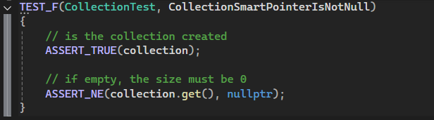
Unit Testing
Does the collection initialize safely?

Slide 9
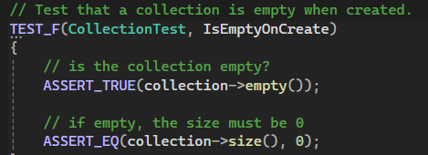
Unit Testing
Is the collection empty when first created?

Slide 10
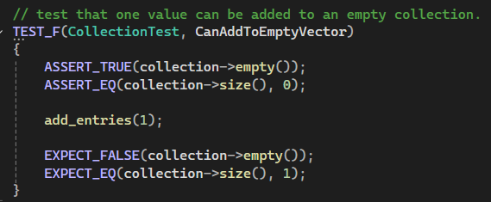
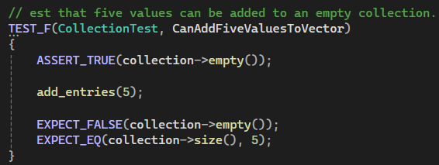
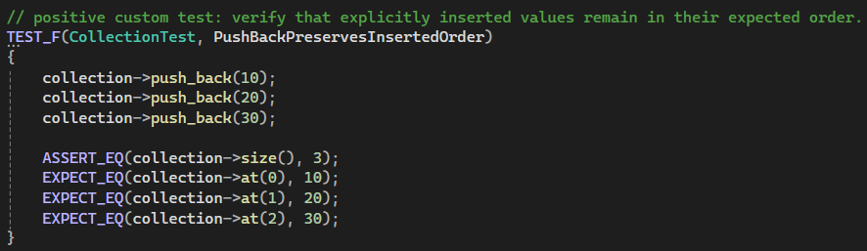
Unit Testing
Can valid values be added to the collection?

Slide 11
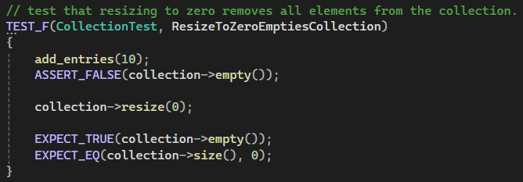
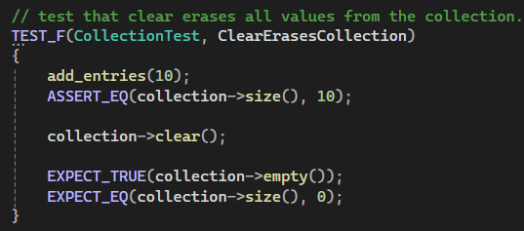
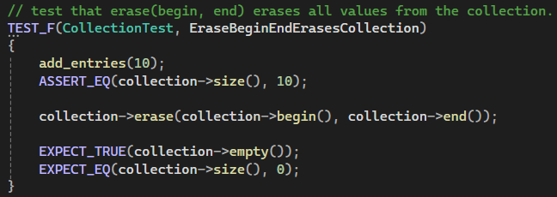
Unit Testing
Does the collection clear data safely?

Slide 12
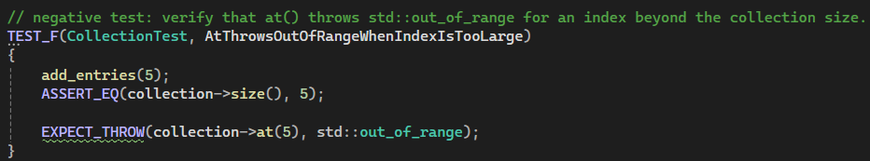
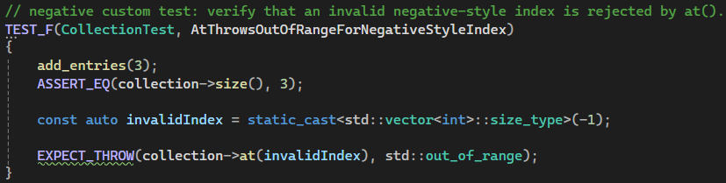
Unit Testing
Does invalid index access get rejected?

Slide 13

AUTOMATION SUMMARY

Slide 14
TOOLS
Green Pace should apply security automation throughout the DevSecOps pipeline, not only at the end of development.
Create
Use compiler warnings, Visual Studio Code Analysis, and IDE security plug-ins to catch issues before code is committed.
Verify
Use Cppcheck, Clang-Tidy, SonarQube, CodeQL, Semgrep, unit tests, and integration tests during pull requests.
Preprod / Release
Use security gates, dependency checks, signed builds, and repeatable test results before deployment. High-risk findings should block release until reviewed or fixed.
Detect / Respond
Use logging, monitoring, firewall logs, operating system logs, anti-malware logs, and incident response review to identify issues after deployment.

Slide 15
RISKS AND BENEFITS
Problem:
As Green Pace grows, secure coding practices may become inconsistent without clear enforcement.
Solution:
Use code reviews, static analysis, compiler warnings, unit testing, and security gates in the DevSecOps pipeline.
Benefits of acting now:
Finding issues early reduces remediation cost, lowers the risk of data exposure, and improves code consistency.
Risks of waiting: Vulnerabilities may move deeper into the lifecycle, making them harder to trace and more damaging in production.
Current gaps: The policy still needs stronger guidance for dependency management, secrets management, recurring reviews, incident response testing, and compliance evidence.
Next steps: Prioritize string correctness, SQL injection, and memory protection first. Then expand testing and review requirements for file access, integer arithmetic, and error handling.

Slide 16
RECOMMENDATIONS
Recommendations: Add stronger guidance for dependency scanning, secrets management, secure configuration, access reviews, and incident response testing.
Current gaps: The policy should better address third-party library risk, credential storage, logging review, secure builds, and long-term maintenance.
Future improvements: Adopt SEI CERT C++ as the main C++ standard, continue using OWASP for injection prevention, NIST for access control and auditing, and Visual Studio unit testing for repeatable checks.

Slide 17
CONCLUSIONS
• Green Pace’s policy helps make secure development clearer, more consistent, and easier to enforce.
• The policy supports defense in depth by combining secure coding standards, encryption, Triple-A controls, automation, testing, and monitoring.
• The highest-priority risks should be addressed first, especially string correctness, SQL injection, and memory protection.
• Automation should be built into each stage of the DevSecOps pipeline so vulnerabilities are caught earlier and reviewed before release.
• The policy should be reviewed and updated regularly as new threats, tools, and development practices appear.

Slide 18
REFERENCES
Carnegie Mellon University Software Engineering Institute. (2017). SEI CERT C and C++ coding standards. https://www.sei.cmu.edu/library/sei-cert-c-and-c-coding-standards/
Microsoft. (2026). Write unit tests for C/C++ in Visual Studio. Microsoft Learn. https://learn.microsoft.com/en-us/visualstudio/test/writing-unit-tests-for-c-cpp
National Institute of Standards and Technology. (2020). Security and privacy controls for information systems and organizations (NIST Special Publication 800-53, Rev. 5). https://csrc.nist.gov/pubs/sp/800/53/r5/upd1/final
OWASP Foundation. (n.d.). SQL injection prevention cheat sheet. OWASP Cheat Sheet Series. https://cheatsheetseries.owasp.org/cheatsheets/SQL_Injection_Prevention_Cheat_Sheet.html
OWASP Foundation. (n.d.). Query parameterization cheat sheet. OWASP Cheat Sheet Series. https://cheatsheetseries.owasp.org/cheatsheets/Query_Parameterization_Cheat_Sheet.html

